Slide 1
Data Science and Artificial Intelligence: Examples From MS Excel to Python
Felix Gonzalez, P.E.
felix.gonzalez@gmail.com
fgonzaleumbc/DATA601.com

Slide 2
Example 1: Can I predict what job pays?
Do all jobs pay the same (e.g., salary, bonus, benefits)?
Why? Why not?
What variables affect pay (i.e., data characteristics)?
What data sources could I use to study the relationship between pay and variables that affect pay?
Could we develop a model that predicts pay?
Could be used to inform career of study
Could be used to inform how well off you are by comparing against the mean and to others in similar careers. This could inform a career change.
Notes:
1b. Education, type of career, industry, company, job experience. Does other variables like gender, racial background plays a role? Should it play a role? From an Ethics standpoint? From a legal standpoint (i.e., are there laws that prevent against a specific behavior?)?
2. There may be a few ways:
Public datasets (e.g., from government agency or collected from a private entity made public)
Non-public (internal datasets)
Create or collect data (e.g., via surveys, analyzing other datasets such as income data)
Some examples of public datasets related to wages:
ISLR2 Library:
1.11 Datasets provided in the ISLR2 package: https://r4ds.github.io/bookclub-islr/datasets-provided-in-the-islr2-package.html
Wage Dataset: https://github.com/JWarmenhoven/ISLR-python/blob/master/Notebooks/Data/Wage.csv
Kaggle Data Science Survey Notebooks:
Notebook Submissions: https://www.kaggle.com/competitions/kaggle-survey-2019/code?competitionId=16394&sortBy=voteCount
Geek Girls Rising Myth or Reality: https://www.kaggle.com/code/parulpandey/geek-girls-rising-myth-or-reality
Spending For MS In Data Science Worth It: https://www.kaggle.com/code/shivamb/spending-for-ms-in-data-science-worth-it
A Guide for Aspiring Data Scientists: https://www.kaggle.com/code/ibtesama/a-guide-for-aspiring-data-scientists
Kaggle Survey 2022 Pay Data: https://github.com/jill-data/Kaggle-survey-2022-DV/tree/main/data

Slide 3
Notes:
Who can tell me or describe what this graph, chart or plot is and represents?
3000 rows of data or records of wage data. Includes the following features year, age, sex, marital status, race, education, region, job class, health, health insurance, log wage, wage. Derived features included estimated education in years, estimated experience, and transforming education data to show the scatter plot with education categories. See the “Wage.xlsx” in the sample data folder.

Slide 4
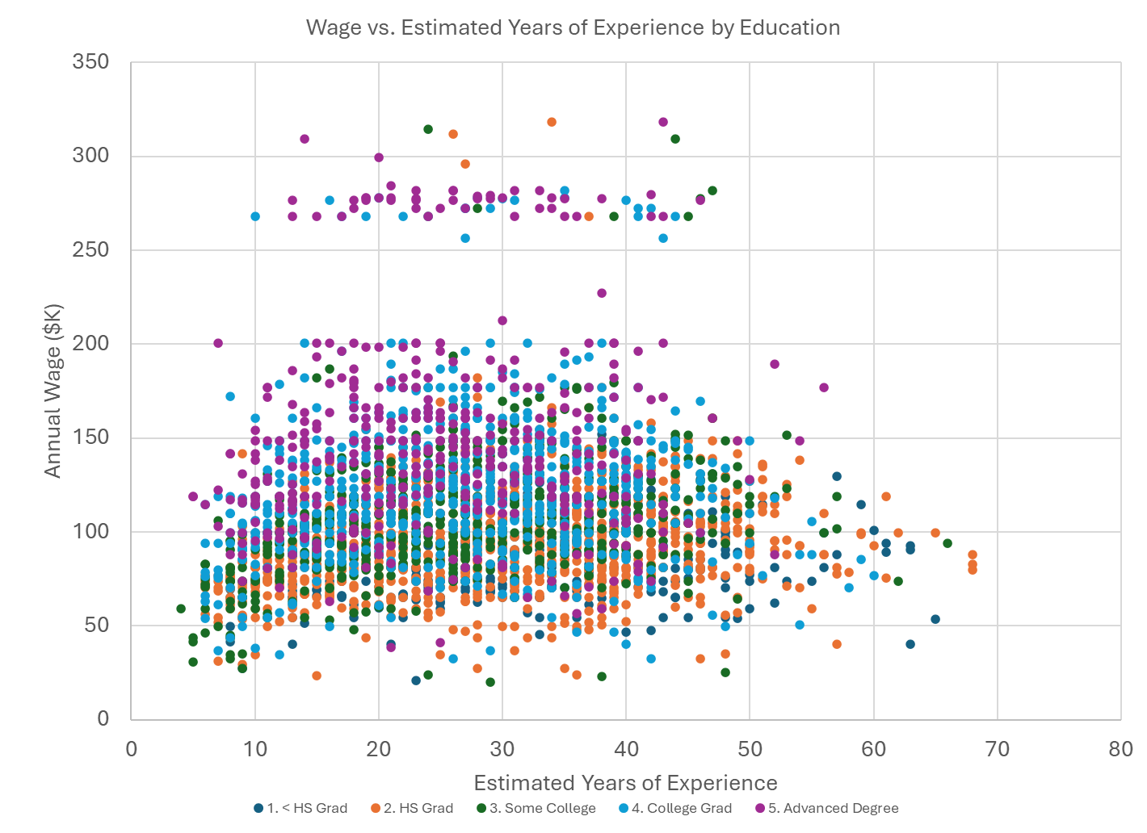
Notes:
The same data before but now added the education.
Do we expect that higher education will result in higher annual wage?
Is this always the case?
We expect that on average higher education should result in higher wage.
A few observations:
Some HS Grads earn as much if not more than those with advanced degrees.
Note that HS Grad has data points in both ends.
Would this be representative of a population? May be yes, maybe not. If not, what can we do about it? Could we collect more data?
What do we expect on average? Does higher education mean higher pay?
Let’s look at the two extremes, <HS and Advanced Degrees.
Note that Simpsons paradox may be observed in some of these clusters or groups of data and is a reason why analysis of different groups is also important.

Slide 5
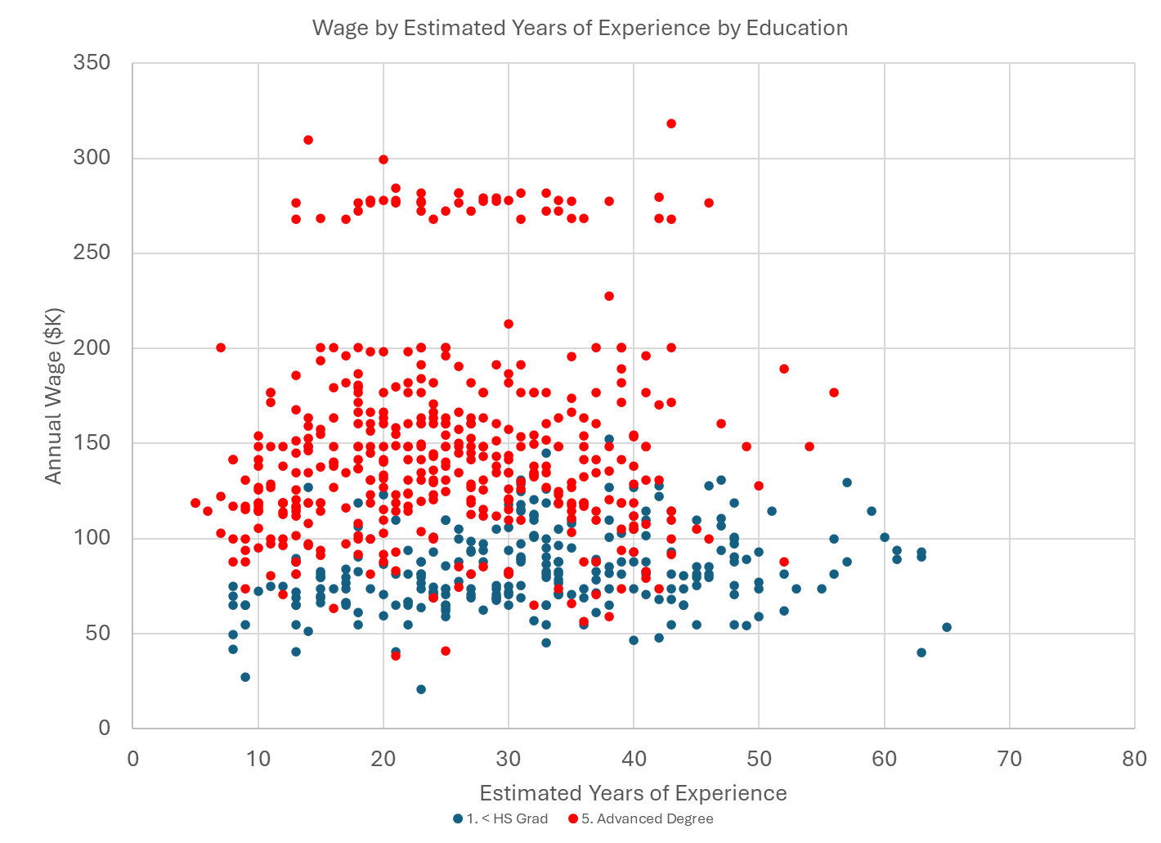
Notes:
On average we expect that higher education may translate to higher wage but may not always be the case.

Slide 6
How can we predict wage?
It is all about the data that we have available:
Many variables that we can model!
Every variable we model may affect pay and the scatter plot in the previous slide in different ways
Can we calculate derived features?
What about mathematical models?
Regression models (e.g., linear vs. polynomial)
Average wages?
Wage Minimum/Maximum?
By groups?
Notes:
Let’s look at total average annual wage vs. estimated years of experience.

Slide 7
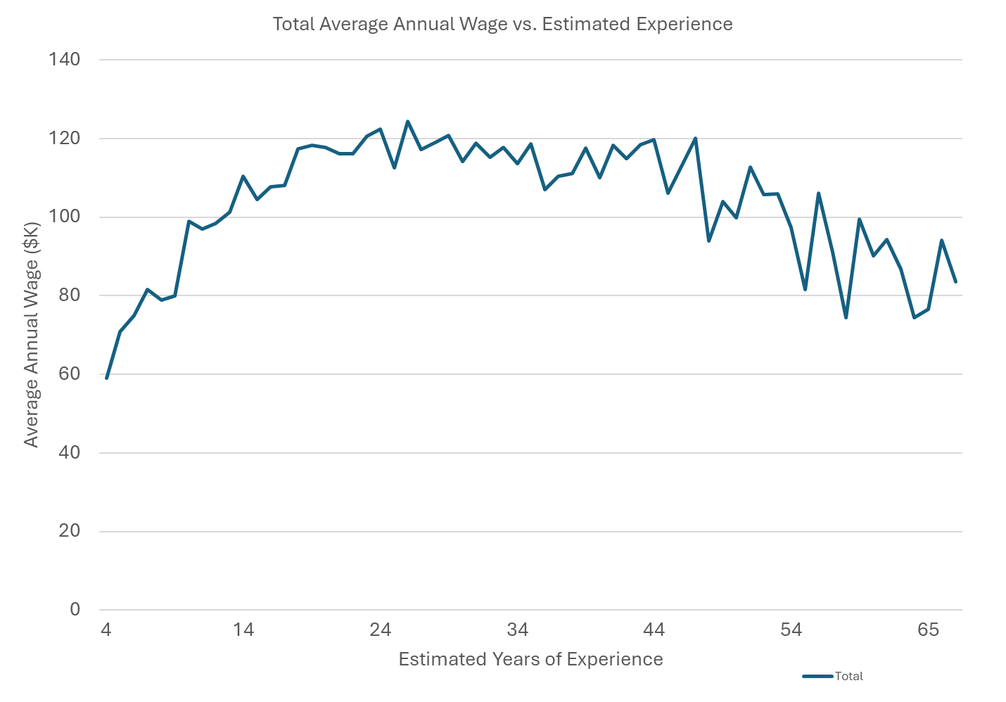
Notes:
What does this tell me?
Any thoughts on why pay may go down after approximately 40 years of age?
This could be due to a multitude of reasons including but not limited:
At more experience people may focus more job flexibilities or benefits rather than on pay.
At more experience people may focus on reduced hours when approaching retirement.
Could this be related to the amount of data that we have?
Perhaps the data at higher estimated years of experience may not be enough or representative of the population?
People at higher levels of wage retire earlier and we do not have data at the higher spectrum of estimated years of experience? Higher wage jobs may have more benefits like pensions, or retirement savings plans.
Or the opposite, people with lower wages having to retire later and we have more data with people with higher experience and less pay at higher estimated years of experience?
Some of these observations may be addressed in the documentation of the dataset. If it is not documented, it is a source of uncertainty in any study that utilizes the data. The important thing is to document these observations.
Once we have documented potential issues, we need to explore various models that we could utilize to model and predict annual wage based on the estimated years of experience. Let’s look at a few.

Slide 8
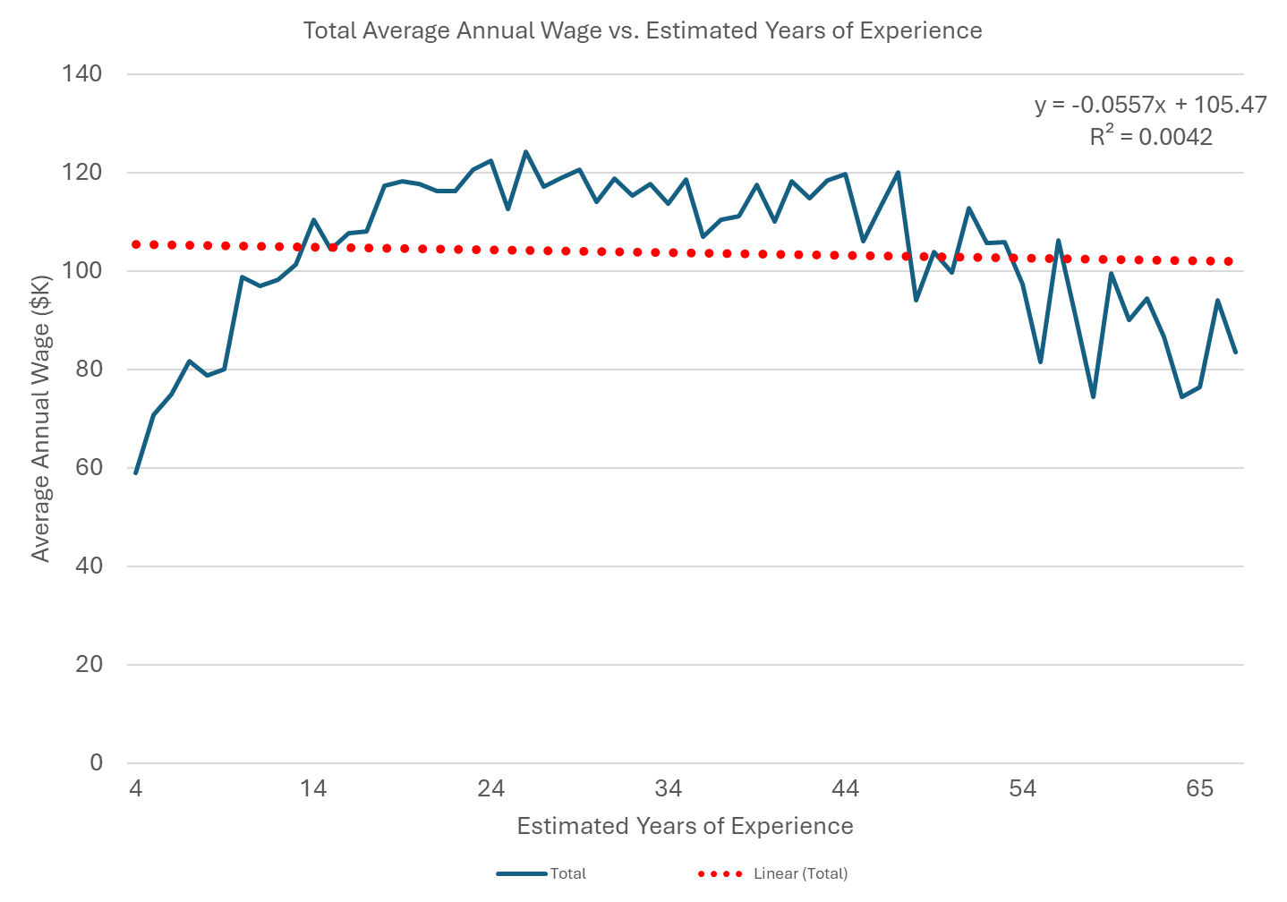
Notes:
Linear Regression Model fitted on the data.
Do you think this is a good model? What about at the tail ends?
Note that the trend using the raw data and linear regression seems to imply that there is a slight increase of annual wage as estimated years of experience increases while here (using the average) seems to imply that the annual wage decreases as estimated years of experience increases.

Slide 9
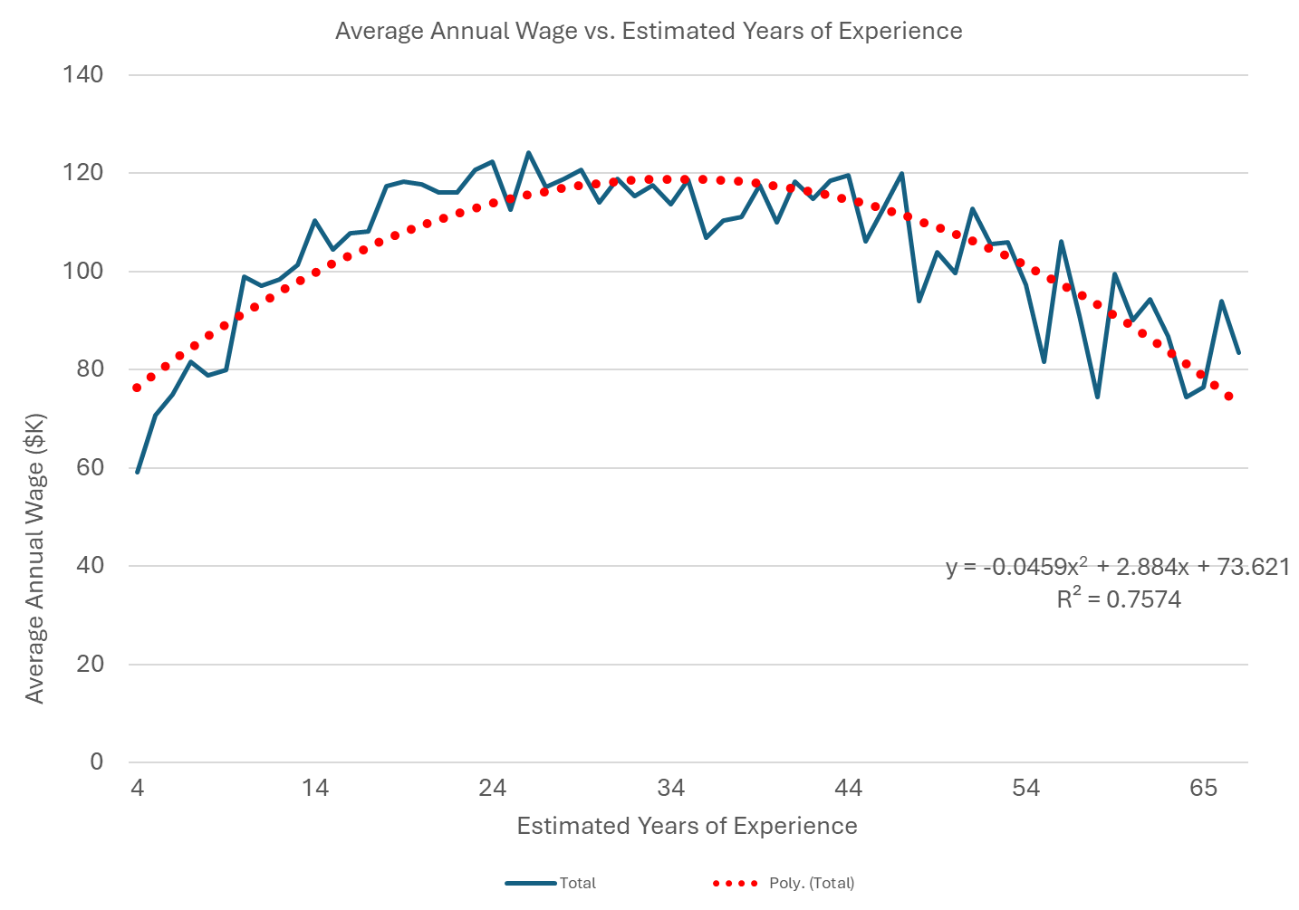
Notes:
Polynomial order of 2 model fitted on the data.

Slide 10
Annual Wage Prediction Model
Which of the models evaluated fit the data best?
Statistics, Supervised ML, and Unsupervised ML models may be used for different tasks and insights.
To get to the point of data plotting, analysis, and model deployment, there were a few things that were skipped:
Data collection
Data cleaning, preparation, and transformation
Documentation
Notes:
Which model fit the data better? Linear or Polynomial Order of 2?
We can look at the R2 value. Typically, the higher the R2 value the better the model fits the data. Typically, good values of R2 are 0.7 or above but varies by industry. A value of 0.7 means that 70% of the data variance is explained by the model.
However, this model does not take into consideration other variables that may affect pay as it is developed using the total average for all groups. To address this, we could develop a multi-variable model or develop a model for each specific situation (e.g., for each level of education). However, the latter may become complicated. Regression models are the simpler of machine learning models and there are many other mathematical models that can be used.

Slide 11
Data Structures
NIST Big Data Framework:
Structured data where each record is consistently structured and could be described efficiently in a relational model
Unstructured data is not organized in a predefined way
Structured data examples: dates, names, numbers, categorical values
Unstructured data examples: text, image, audio, and video
Before analyzing data, we need to resolve data quality issues

Slide 12
Example: Data Features/Columns
Structured Data | Unstructured Data
show_id | type | country | release_yr | rating | listed_in | title | description
s1 | Movie |  | 2021 | TV-PG | Documentary | A Spark Story | Two Pixar filmmakers strive to bring their uniquely personal SparkShorts visions to the screen.
s2 | Movie | United States, Canada | 2011 | G | Comedy, Fantasy, Kids | Spooky Buddies | The puppies go on a spooky adventure through a mysterious haunted mansion in this fur-raising flick.
s3 | Movie | United States | 2014 | PG-13 | Coming of Age, Drama, Romance | The Fault in Our Stars | Hazel and Gus share a love that sweeps them on an unforgettable journey.
s4 | TV Show | United States | 2019 | TV-PG | Animals & Nature, Docuseries, Family | Dog: Impossible | Matt Beisner uses unique approaches to modifying canine behavior and focuses on each animalâ€™s needs.
s5 | TV Show | United States | 2021 | TV-Y | Action-Adventure, Animation, Kids | Spidey And His Amazing Friends | Spidey teams up with pals to become The Spidey Team!
s6 | TV Show |  | 2021 | TV-PG | Action-Adventure, Animation, Anime | Star Wars: Visions | An animated anthology celebrating Star Wars through the lens of the worldâ€™s best anime creators.

Slide 13
Hypothetical Example: Data Cleaning/Wrangling/Preparation
Is this column Structured or Unstructured data?
As shown, it is Unstructured
Structured data is much easier to clean and analyze. Consider this when collecting data.
show_id | type | title | country | release_yr | rating | duration | listed_in | description
s1 | Movie | A Spark Story |  | 2021 | TV-PG | 88 min | Documentary | Two Pixar filmmakers strive to bring their uniquely personal SparkShorts visions to the screen.
s2 | Movie | Spooky Buddies | United States, Canada | 2011 | G | 93 min | Comedy, Fantasy, Kids | The puppies go on a spooky adventure through a mysterious haunted mansion in this fur-raising flick.
s3 | Movie | The Fault in Our Stars | United States | 2014 | PG-13 | 127 min | Coming of Age, Drama, Romance | Hazel and Gus share a love that sweeps them on an unforgettable journey.
s4 | TV Show | Dog: Impossible | United States | 2019 | TV-PG | 2 Seasons | Animals & Nature, Docuseries, Family | Matt Beisner uses unique approaches to modifying canine behavior and focuses on each animalâ€™s needs.
s5 | TV Show | Spidey And His Amazing Friends | United States | 2021 | TV-Y | 1 Season | Action-Adventure, Animation, Kids | Spidey teams up with pals to become The Spidey Team!
s6 | TV Show | Star Wars: Visions |  | 2021 | TV-PG | 1 Season | Action-Adventure, Animation, Anime | An animated anthology celebrating Star Wars through the lens of the worldâ€™s best anime creators.
Notes:
In many cases mixing disparate data sources may cause issues like this. In this case the definition of duration for a TV Show is different from a Movie.

Slide 14
Hypothetical example: Data Cleaning/Wrangling/Preparation
Examples of data issues: errors, potentially missing values, null values, duplicates, and outliers
show_id | type | title | country | release_yr | rating | duration | listed_in | description
s1 | Movie | A Spark Story |  | 2021 | TV-PG | 188 min* | Documentary | Two Pixar filmmakers strive to bring their uniquely personal SparkShorts visions to the screen.
s2 | Movie | Spooky Buddies | United States, Canada | 2030* | G | 93 min | Comedy, Fantasy, Kids | The puppies go on a spooky adventure through a mysterious haunted mansion in this fur-raising flick.
s4 | TV Show | Dog: Impossible | United States | 2019 | TV-PG | 2 Seasons | Animals & Nature, Docuseries, Family | Matt Beisner uses unique approaches to modifying canine behavior and focuses on each animalâ€™s needs.
s4* | TV Show | Star Wars: Visions |  | 2021 | TV-PG | 1 Season | Action-Adventure, Animation, Anime | An animated anthology celebrating Star Wars through the lens of the worldâ€™s best anime creators.
Evaluate data quality, accuracy, and consistency.
How to address data issues:
Drop duplicates, errors and missing values?
Use group mean? Use mean of adjacent data points? Use the maximum value?
Can errors be rectified?
Will outliers and errors skew data?
Notes:
*Asterisks are hypothetical examples.
Fixing issues in text (e.g., special characters) sometimes is very challenging.

Slide 15
Derived Features/Columns
Example of derived data features/columns
year | age | sex | education | jobclass | health_ins | wage | estimated education yrs | estimated experience
2006 | 18 | 1. Male | 1. < HS Grad | 1. Industrial | 2. No | 75 | 10 | 8
2004 | 24 | 1. Male | 4. College Grad | 2. Information | 2. No | 70 | 16 | 8
2003 | 45 | 1. Male | 3. Some College | 1. Industrial | 1. Yes | 131 | 14 | 31
2003 | 43 | 1. Male | 4. College Grad | 2. Information | 1. Yes | 155 | 16 | 27
2005 | 50 | 1. Male | 2. HS Grad | 2. Information | 1. Yes | 75 | 12 | 38
2008 | 54 | 1. Male | 4. College Grad | 2. Information | 1. Yes | 127 | 16 | 38
2009 | 44 | 1. Male | 3. Some College | 1. Industrial | 1. Yes | 170 | 14 | 30
2008 | 30 | 1. Male | 3. Some College | 2. Information | 1. Yes | 112 | 14 | 16
Notes:
Estimated education in years is calculated from Education column and the following assumptions:
"1. < HS Grad", 10
“2. HS Grad", 12
"3. Some College", 14
“4. College Grad", 16
"5. Advanced Degree", 20
Estimated experience is calculated from Age minus Estimated Education years.

Slide 16
Data Considerations (1/2)
Enough data- - -Data- - -Big Data
Structured vs. unstructured data
Sample data may not be representative of the population.
Data balance? Are all categorical values represented in a balanced manner?
Supervised ML problems divide data into training and testing sets
80% data for training (i.e., teaching the model)
20% testing (i.e., evaluating model accuracy)
https://machinelearningmastery.com/much-training-data-required-machine-learning/
https://towardsdatascience.com/how-do-you-know-you-have-enough-training-data-ad9b1fd679ee
Notes:
Amount of data is dependent on what you want to do.
Not having enough data may cause several issues:
Data balance
Sample data may not be representative of the population.
Error may skew the data.
Will not have enough data to reliably train/test a ML model.

Slide 17
Data Considerations (2/2)
Complexity of problem and model
Number of features, classes, etc.
Feature engineering used to identify features that have predictive power
Model computational requirements (e.g., linear regression vs. neural network)
High dimensional problems may benefit from dimensionality reduction
Larger complexity may require larger amounts of data
Data Ethical considerations
Risk considerations (e.g., for safety related equipment)?
Were effects of negative results evaluated (e.g., predicting the wrong class, false positives, false negatives)?
Data balance and data bias issues evaluated and addressed?

Slide 18
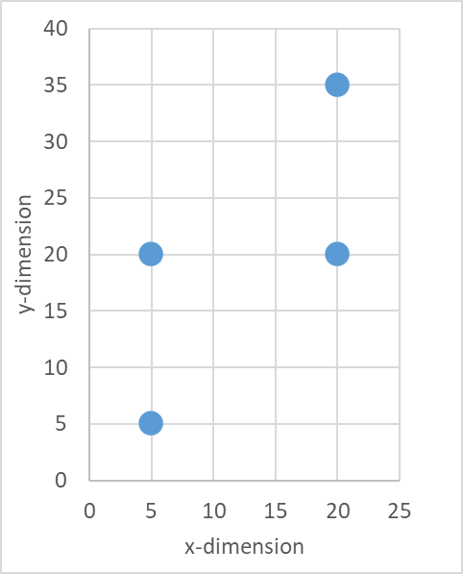
Example 2: Similarity Metrics
I have 4 points/labels: A, B, C, D.
Which point is MOST similar to A?
I have a new point E:
Which point/label (A, B, C, D) is MOST similar to point E?
Which point/label (A, B, C, D) is LEAST similar to point E?
Which label should I apply to Point E?
A, B, C, D?
How did you come up to the conclusion?
D
B
C
E
A
Notes:
In a classification problem I have labeled data (e.g., in this case data points A, B, and C in a 2-dimensional scatter plot) I want to label new records (e.g., new data points) in one of the three labels.
Labels can be anything typically categorical values (A, B or C, or Bad, Good, Very Good, or a score numbers 1 through 10).
There is no correct or wrong answer. There may be different logical explanations on how you get to your conclusion. Conclusions may be the same when using different methods or they may be different.
Survey: “Which point/label is most similar to point D?” A, B, or C?
Survey: “Which point/label is least similar to point D?” A, B, or C?
Survey: “Which label should I apply?” A, B, or C?
Open mic question: “How did you come up to the conclusion?”

Slide 19
Similarity Metrics
Quantification of the similarity between two objects.
Common similarity metrics:
Euclidian distance
Cosine similarity
Edit distance
Levenshtein
Jaccard index/similarity
Hamming distance
Manhattan distance
Similarity metrics can be used in various AI applications:
Classification
Clustering
Information retrieval (e.g., similarity searching, spelling recommendation)

Slide 20
Euclidean Distance and Cosine Similarity
Euclidian distance uses the length between two points (or vectors) as a measure of similarity
Cosine similarity uses the angles between two points (or vectors) as a measure of similarity
Next slide:
Example of similarity between three points in a cartesian plane
Calculation using Euclidian distance
Calculation using cosine similarity

Slide 21

Similarity Example
Euclidian Distance
Cosine Similarity
B
C
B
C
A
$$θ$$
A
Description | Euclidean Distance
Euclidian Distance between A and B | 3
Euclidian Distance between A and C | 3.16
The closer the Euclidian distance is to 0 the more similar the points.
Description | Angle | Cosine of Angle
Cosine Similarity between A and B | 30.96º | 0.86
Cosine Similarity between A and C | 18.43º | 0.95
The closer the cosine of the angle is to 1 the more similar the points.
Notes:
Cosine Function in MS Excel: https://support.microsoft.com/en-us/office/cos-function-0fb808a5-95d6-4553-8148-22aebdce5f05

Slide 22
Example 3: Spell Check
Edit distance metric is sometimes used in spell checking. Edit distance calculates how dissimilar two words are by counting the number of operations required to transform one word to another.
Words are most probably recommended in order of the edit distance metric score and potentially only recommend those words that meet a minimum score.
Example: “engineering” miss-spelling recommendations:
“engenereing” vs.
“enchineering” vs.
“engineerin” vs.
“endineering” vs.
“enhineering”
Because this is proprietary software, we may not be able to confirm which distance metric the software uses.

Slide 23
Ethical Principles (1/2)
Main goal: protect privacy, civil rights, civil liberties, and American values consistent with applicable laws
Identification and understanding of potential bias, inequities, societal concerns, and other risks
Development, testing, and deployment
Performed by multi-disciplinary team
In coordination with stakeholders' input (e.g., domain experts, industry, public, etc.)
Recommends system have Human-in-the-loop
Reliable, reproducible, traceable, transparent outputs (as permitted by algorithms and the system)
Notes:
There are many ethical frameworks that discuss ethical principles and considerations. The slides here present general and notable goals, principles, and considerations. AI Algorithms can be setup to automatically make decisions. Because of this and many other things there are many ethical precautions and principles that we should be following.

Slide 24
Ethical Principles (2/2)
Security and privacy
Supervision, oversight, and accountability
Documentation: Promotes transparency and trust by providing information on system design, operation and limitations
Defined scope, goals, roles and responsibilities
Data source and selection process
Model specifications and parameters
Methods for assessment
Performance metrics and outcomes
Risk management plan to identify, analyze and mitigate risks

Slide 25

Questions?

